Slide 1
3.3 Methods
ITP3914 – Programming
Part 3 – Basic Program Structures

Slide 2

Part 1 – Calling a method

Slide 3
How does a method look like?
import java.util.Scanner;
public class StudentMarks {
}
public static void main(String [ ] args) {
Scanner kb = new Scanner(System.in);
int x = kb.nextInt();
int y = kb.nextInt();
double avg = calAverage(x, y);
System.out.println("Average=" + avg);
int max = findMax(x, y);
System.out.println("Max=" + max);
}
Method
public static double calAverage (int x, int y) {
…
}
Method
public static int findMax (int x, int y) {
…
}
Method

Slide 4
Method declaration
public static double calAverage(int x, int y)
{
…
}
Method Header
Access
Specifier
Method Type
Optional
Parameters
Optional
Modifier(s)
Method Name
Access specifiers and modifiers will be discussed in topic 4.

Slide 5

Calling a method
public class M1 {
}
public static void main(String [ ] args) {
System.out.println("In main");
sayHello();
System.out.println("Back to main");
}
c:\> java M1
c:\> java M1
In main
c:\> java M1
In main
Hello
c:\> java M1
In main
Hello
Back to main
public static void sayHello() {
System.out.println("Hello");
}

Slide 6




Calling a method
I am the Boss!!!
public class M1 {
}
public static void main(String [ ] args) {
System.out.println("In main");
sayHello();
System.out.println("Back to main");
}
c:\> java M1
c:\> java M1
In main
c:\> java M1
In main
Hello
c:\> java M1
In main
Hello
Back to main
public static void sayHello() {
System.out.println("Hello");
}
I am
a worker!!

Slide 7
Calling a method
To call a method, write its name (i.e. sayHello) followed ().
When a method is called, the program flows to execute the method and the caller suspends.
When execution reaches the closing brace (}), the method terminates.
The program then flows “back” to the caller which then resumes execution.
public class M1 {
}
public static void main(String [ ] args) {
System.out.println("In main");
sayHello();
System.out.println("Back to main");
}
public static void sayHello() {
System.out.println("Hello");
}

Slide 8
The return statement
import java.util.Scanner;
public class M2 {
}
Whenever execution reaches the return statement, the method terminates, and
execution returns to the caller immediately.
public static void main(String [ ] args) {
System.out.println("In main");
sayHello();
System.out.println("Back to main");
}
c:\> java M2
In main
30
Hello
Back to main
public static void sayHello() {
Scanner kb = new Scanner(System.in);
int number = kb.nextInt();
if ( number==0 )
return;
System.out.println("Hello");
}
c:\> java M2
In main
0
Back to main

Slide 9
Parameter passing
When calling a method, an argument can be provided (in this example, 30).
public class M3 {
}
public static void main(String [ ] args) {
System.out.println("In main");
showValue ( );
System.out.println("Back to main");
}
The argument is passed to the called method (in this example, showValue).
30
30
The method must have a parameter variable to store the argument value.
int value
public static void showValue( ) {
System.out.println(value);
}
30
Declare a variable!!!!
value
c:\> java M3
In main
c:\> java M3
In main
30
c:\> java M3
In main
30
Back to main
When the method terminates, the parameter variable is destroyed.
When the method is entered, the parameter variable is created.

Slide 10
Multiple parameters
Multiple argument values can be sent to the method (in this example, 4 and 12).
public class M4 {
}
public static void main(String [ ] args) {
System.out.println("In main");
showSum (4, 12);
System.out.println("Back to main");
}
Yes, I know. Two variables are needed this time.
4
12
int x, int y
public static void showSum( ) {
System.out.println( x+y );
}
4
12
x
y
c:\> java M4
In main
c:\> java M4
In main
16
c:\> java M4
In main
16
Back to main
When the method terminates, the parameter variables are destroyed.
When the method is entered, the parameter variables are created.

Slide 11
Local variables
A method can define its own variables.
Such variables can only be used within the method.
They are thus called local variables.
Local variables are created upon entering and destroyed upon leaving the method.
public class M5 {
}
public static void main(String [ ] args) {
System.out.println("In main");
showSum (4, 12);
System.out.println("Back to main");
}
Yes, I know. Two variables are needed this time.
4
12
int x, int y
public static void showSum( ) {
int sum;
sum = x + y;
System.out.println( sum );
}
16
4
12
sum
x
y
c:\> java M5
In main
c:\> java M5
In main
16
c:\> java M5
In main
16
Back to main
When the method terminates, the parameter and local variables are destroyed.
When the method is entered, the parameter and local variables are created.

Slide 12
An example
public class M6 {
}
public static void main(String [ ] args) {
sayHello();
showValue(30);
showSum(3, 4);
discount(100, 0.9);
}
public static void showSum(int x, int y) {
int sum;
sum = x + y;
System.out.println(sum);
}
The two arguments are having different data types.
public static void sayHello() {
System.out.println("Hello");
}
public static void showValue(int value) {
System.out.println(value);
}
public static void discount(int amount, double rate) {
System.out.println(amount * rate);
}
c:\> java M6
Hello
30
7
90

Slide 13
Part 2 – Method return values

Slide 14

Method return value
A method may send back a reply to the caller, that is, “returning” a result.
In this example, return sum returns the value 16 to the caller.
Since the method showSum() produces an int result, its type is defined as int.
public class M7 {
}
public static void main(String [ ] args) {
int sum;
sum = showSum (4, 12);
System.out.println("Sum = " + sum);
}
16
4
12
How can the caller receive the return value?
int x, int y
public static int showSum( ) {
int sum;
sum = x + y;
return sum;
}
16
4
12
sum
x
y

Slide 15
Receiving return value
public class M7 {
}
public static void main(String [ ] args) {
int sum;
sum = showSum (4, 12);
System.out.println("Sum = " + sum);
}
16
sum
16
showSum(4, 12);
16
public static int showSum( int x, int y ) {
int sum;
sum = x + y;
return sum;
}
16
4
12
sum
x
y
Note that variable sum in main() and the local variable sum in method showSum() are two different variables.

Slide 16
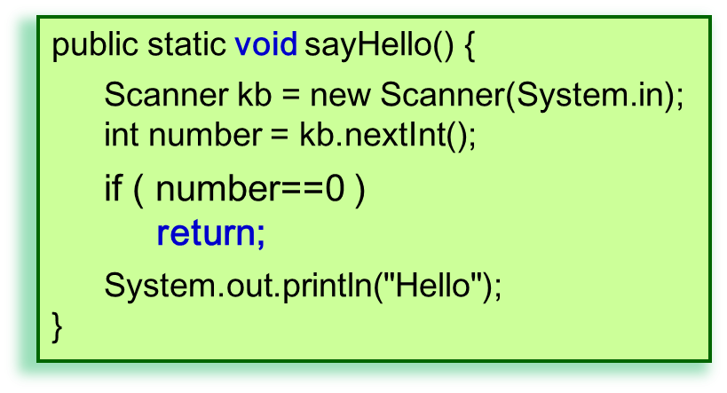
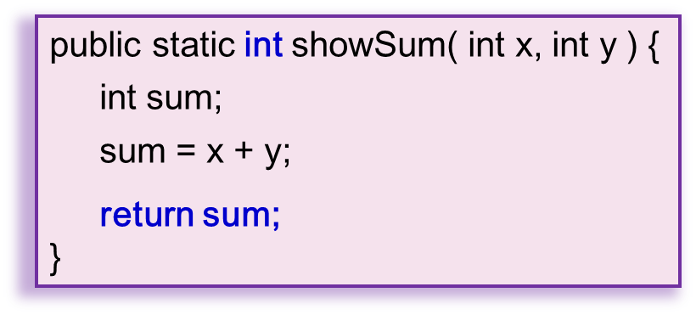

The return statement
The return statement causes a method to terminate and execution returns to the caller.
First form: return;
Used when a method produces no value.
The method type must therefore be void.
Second form: return expression;
Used when a method returns the expression value to the caller.
The method type must be the same as the data type of expression (and must not be void).

Slide 17


Exercises
public static void myMethod() {
…
}
public static void myMethod() {
…
return;
}
public static void myMethod() {
…
return x;
}

Slide 18
Exercises
public static int myMethod() {
…
}
public static int myMethod() {
…
return;
}
public static int myMethod() {
int x;
…
return x;
}

Slide 19
public static int myMethod() {
float f;
…
return f;
}
public static int myMethod() {
int x;
float f;
…
if (…)
return x;
else
return f;
}

Slide 20
Part 3 – More advanced

Slide 21
Pass-by-value
c:\> java PbyV
a=1, b=2
x=1, y=2
x=2, x=1
a=1, b=2
public class PbyV {
}
public static void main(String [ ] args) {
int a=1, b=2;
System.out.println("a=" + a + ", b=" + b);
swap(a, b);
System.out.println("a=" + a + ", b=" + b);
}
With pass-by-value, a copy of the argument’s value is made and passed to the called method.
The method then creates a local parameter variable to store the value.
Primitive data type arguments are always passed by value.
boolean, char, byte, short, int, long, float, double
a
1
b
2
1
2
public static void swap (int x, int y) {
System.out.println("\tx=" + x + ", y=" + y);
int temp=x;
x = y;
y = temp;
System.out.println("\tx=" + x + ", y=" + y);
}
x
2
y
1
temp
1

Slide 22
Method overloading
public class FindAverage {
}
public static void main(String [ ] args) {
double avg;
avg = average(5, 6);
System.out.println("Average=" + avg);
avg = average(5, 6, 7);
System.out.println("Average=" + avg);
}
Several different methods having the same name.
Each overloaded method must have a different parameter set:
number of parameters
parameter types
Java will call the appropriate method by matching the argument(s) against the parameter(s).
public static double average (int a, int b) {
return (a+b)/2.0;
}
public static double average (int a, int b, int c) {
return (a+b+c)/3.0;
}
c:\> java FindAverage
Average=5.5
Average=6.0

Slide 23

Method overloading²
public class FindMax {
}
findMax() calling another findMax()
public static void main(String [ ] args) {
int max;
max = findMax (5, 3);
System.out.println("max=" + max);
max = findMax (5, 3, 9);
System.out.println("max=" + max);
}
public static int findMax (int x, int y) {
return (x > y) ? x : y;
}
public static int findMax (int x, int y, int z) {
int max;
max=findMax(x, y);
max=findMax(max, z);
return max;
}
c:\> java FindMax
max=5
max=9

Slide 24
Method overloading³
public class WrongAverage {
}
public static void main(String [ ] args) {
int iavg = average(5, 6);
System.out.println("Average=" + iavg);
double davg = average(7, 8);
System.out.println("Average=" + davg);
}
Return type cannot be used to distinguish overloaded methods.
public static double average(int a, int b) {
return (a+b)/2.0;
}
public static int average(int a, int b) {
return (a+b)/2;
}
c:\> javac WrongAverage.java
WrongAverage.java:14: error: method average(int, int) is already defined in class WrongAverage
public static double average(int a, int b) {
^
1 error

Slide 25

Argument promotion
Usually the argument(s) match the data type of parameter(s).
When calling a method, if Java can make the data type conversion without loss of information, it will do so automatically.
public class DoubleAverage {
}
public static void main(String [ ] args) {
double avg;
avg = average(5.1, 6.3);
System.out.println("Average=" + avg);
avg = average(4, 6.7);
System.out.println("Average=" + avg);
avg = average(9, 7);
System.out.println("Average=" + avg);
}
From small …to large
public static double average(double a, double b) {
return (a+b)/2;
}
c:\> java DoubleAverage
Average=5.699999999999999
Average=5.35
Average=8.0

Slide 26
Overloading + Argument promotion
public class FindAverage2 {
}
avg = average(9, 4.5);
public static void main(String [ ] args) {
double avg;
System.out.println(avg);
}
avg = average(11.3, 8);
avg = average('A', 'C');
public static double average(char a, int b) {
return (a+b)/2.0;
}
public static double average(int a, double b) {
return (a+b)/2.0;
}
public static double average(double a, int b) {
return (a+b)/2.0;
}

Slide 27
Overloading + Argument promotion
public class FindAverage2 {
}
public static void main(String [ ] args) {
double avg;
System.out.println(avg);
}
avg = average(11, 8);
FindAverage2.java:4: error: reference to average is ambiguous, both method average
(int,double) in FindAverage2 and method average(double,int) in FindAverage2 match
avg = average(11, 8);
^
1 error
public static double average(char a, int b) {
return (a+b)/2.0;
}
avg = average(11.3, 8.2);
public static double average(int a, double b) {
return (a+b)/2.0;
}
FindAverage2.java:4: error: no suitable method found for average(double,double)
avg = average(11.3, 8.2);
^
method FindAverage2.average(double,int) is not applicable
(actual argument double cannot be converted to int by method invocation conversion)
method FindAverage2.average(int,double) is not applicable
(actual argument double cannot be converted to int by method invocation conversion)
method FindAverage2.average(char,int) is not applicable
(actual argument double cannot be converted to char by method invocation conversion)
1 error
public static double average(double a, int b) {
return (a+b)/2.0;
}

Slide 28
END

